Slide 1
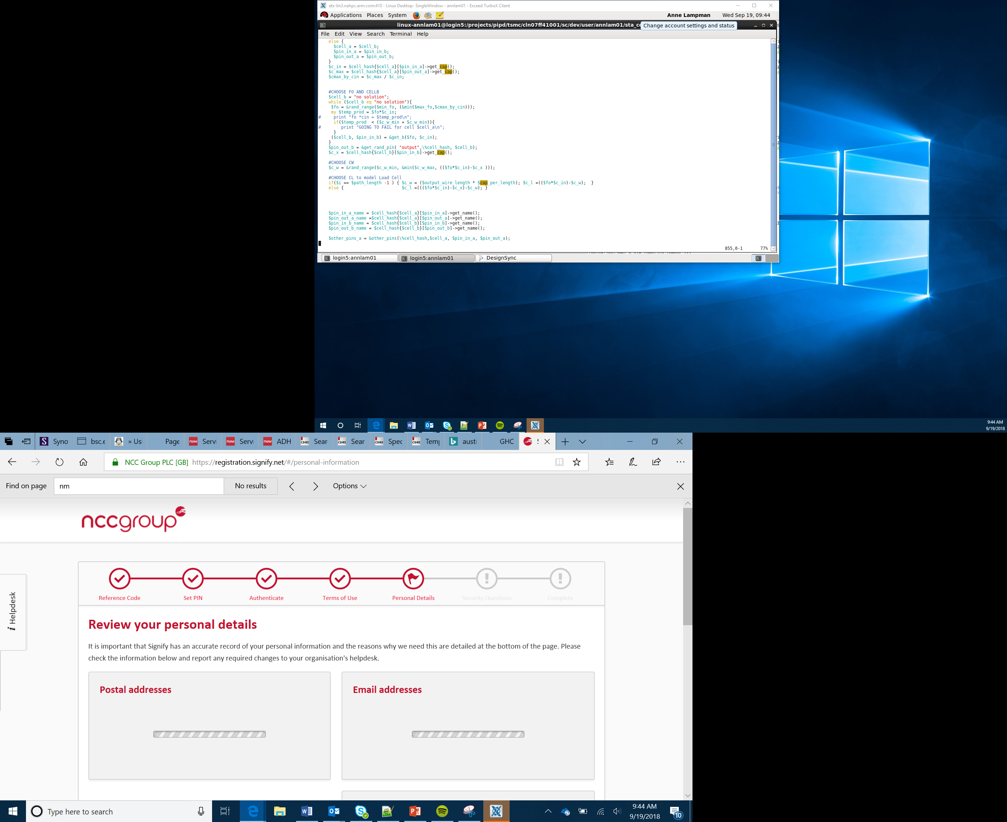

Acceleration and the Accelerometer
Lesson 16

Slide 2
What the Lesson Will Cover
Know what an acceleration is
Define the role of an accelerometer
Be aware of the three axes x, y and z
Use code to measure acceleration on one axis and respond to reading
Apply understanding to measure acceleration on two or three axes and code responses

Slide 3
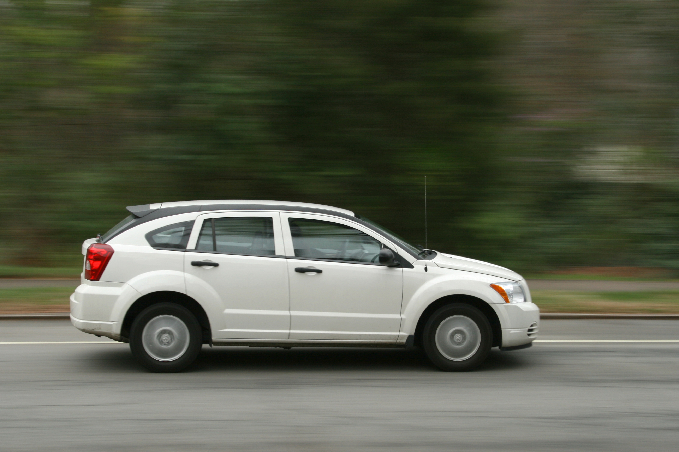
Acceleration
Acceleration is defined as the change in velocity over a period of time
Velocity is not the same as speed
Velocity has a direction, 25 kilometres per hour (kph) is a speed, however 25kph east is a velocity
Imagine a car, the faster the change in velocity the quicker its acceleration
This Photo by Unknown Author is licensed under CC BY-SA

Slide 4
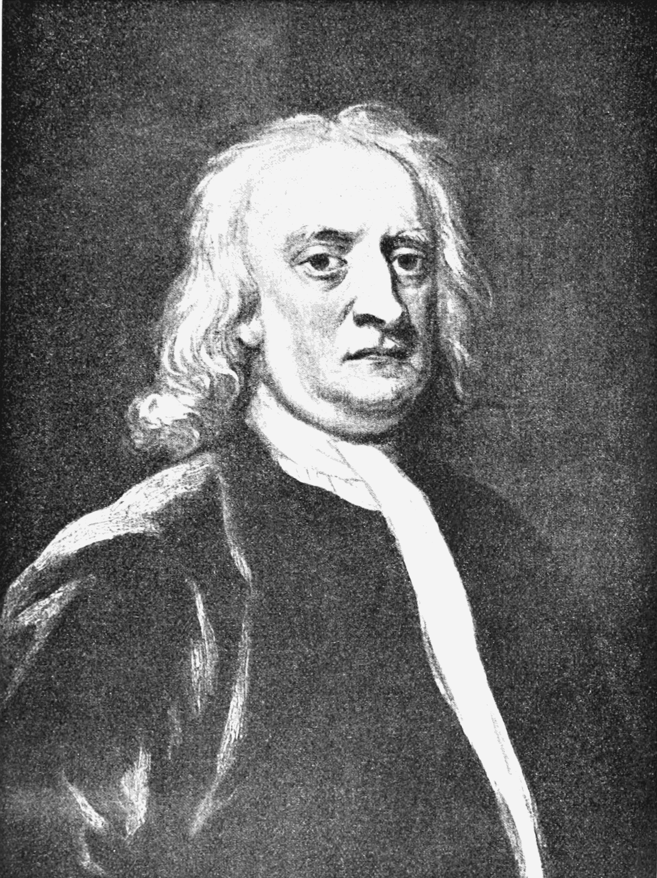
Acceleration and the Accelerometer
An accelerometer measures changes in acceleration.
Acceleration is calculated using Newton’s classic equation
Force = mass x acceleration
Therefore acceleration = force / mass
This Photo by Unknown Author is licensed under CC BY-SA

Slide 5
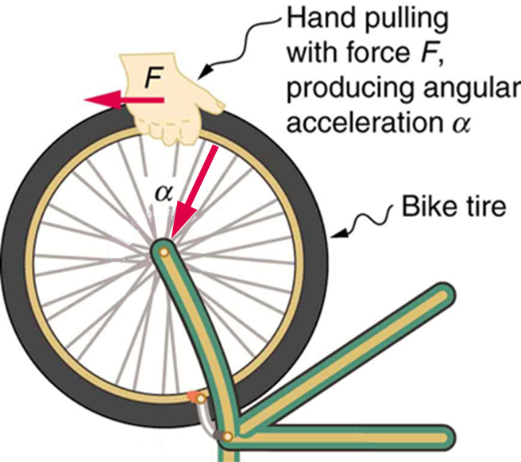
Acceleration and the Accelerometer
Acceleration = force / mass
Consider riding your bike, as you ride your bike, the mass does not change
However as you speed up, slow down, turn and brake the force will change
Therefore the new acceleration can be calculated

Slide 6
The Accelerometer
The micro:bit’s accelerometer contains a tiny electrode that moves whenever the micro:bit is moved
If the force is enough the electrode makes contact with other electrodes
This contact makes a circuit and a digital signal is then sent back to the program
This digital signal is processed and interpreted to establish the amount of acceleration

Slide 7
Three Axes – x, y and z
Thank about an Aeroplane – it can move:
Up and down
Forward and back
Left and right
If we pair these up we get three axes – x, y and z
Acceleration can occur along each of the three axes x, y and z
y
Up
Back
x
left
Right
Fwd
Down
z

Slide 8
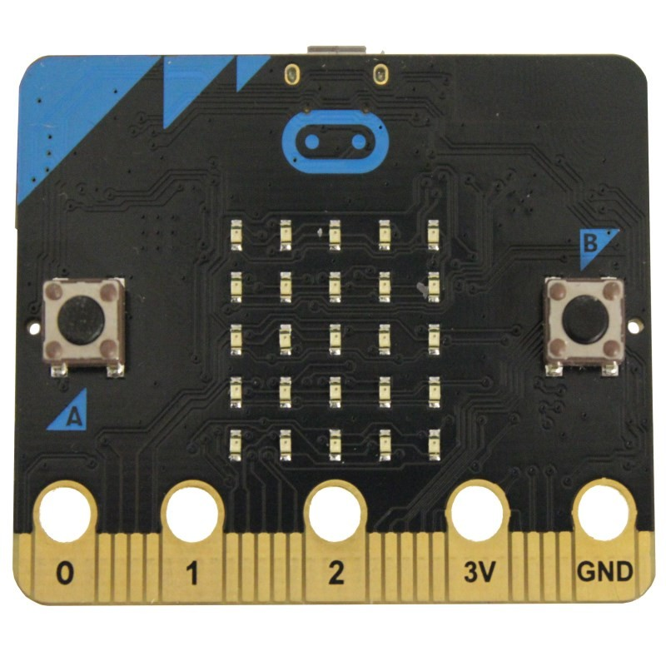
x-axis
This refers to the acceleration to the right or left
Hold the micro:bit and tilt it to the right or left and it will respond

Slide 9
y-axis
This refers to the acceleration to the upward and down
Hold the micro:bit and tilt it downward or toward yourself

Slide 10
z-axis
This refers to the acceleration from moving the micro:bit up or down
Hold the micro:bit flat and lift it up or down

Slide 11
Program to Measure Acceleration on the x-axis
from microbit import *
while True:
reading = accelerometer.get_x()
if reading > 20:
display.show("R")
elif reading < -20:
display.show("L")
else:
display.show("-")
Notes:
Discuss the program,
A reading is taken and stored in the variable, then selection is used to compare the value to > 20 or < 20. The micro:bit responds with the direction shown in, either Right or Left.
Activity part 1

